Slide 1
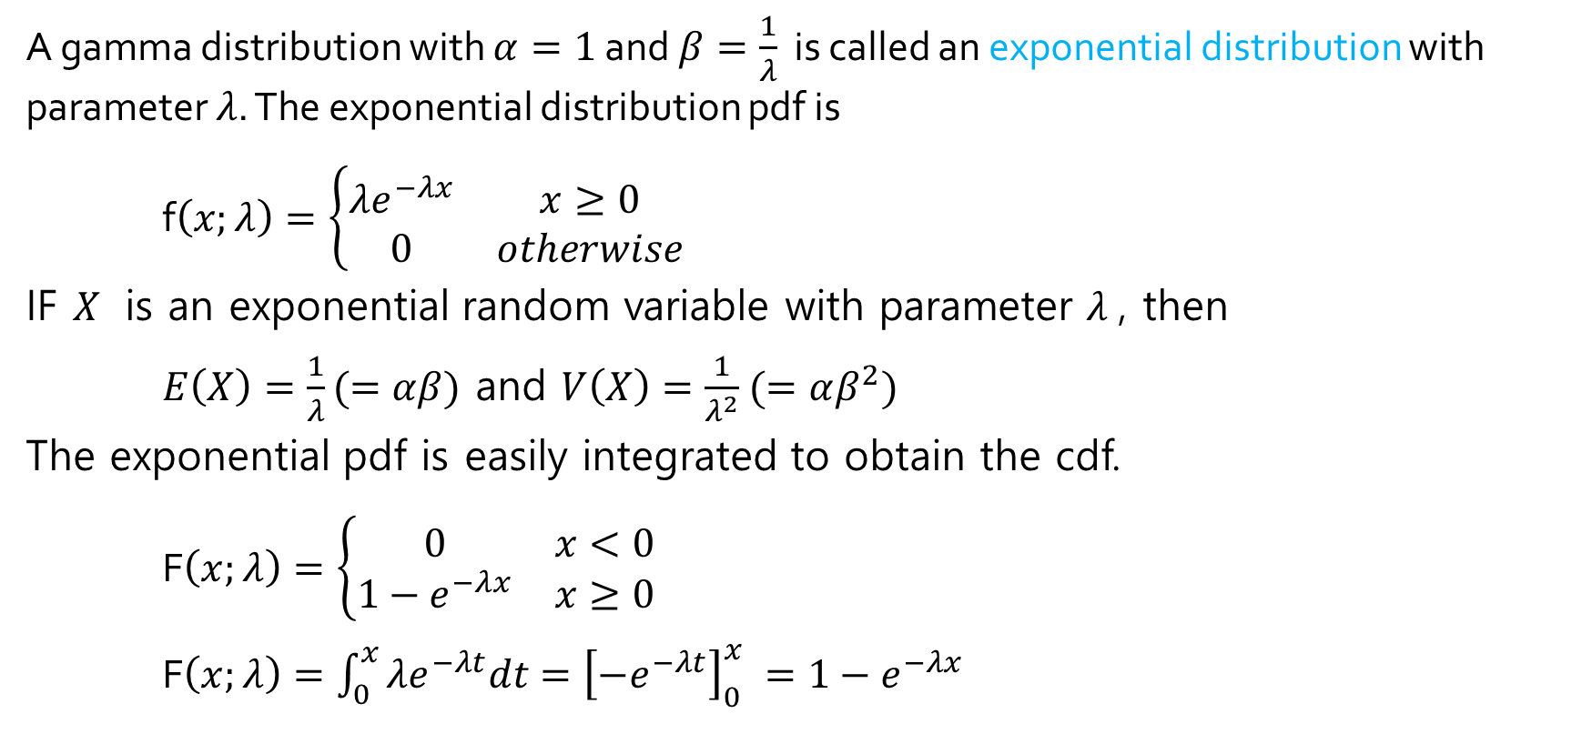
The exponential distribution
A gamma distribution with $α=1$ and $β=\frac{1}{λ}$ is called an exponential distribution with parameter $λ$. The exponential distribution pdf is
f$\left(x;λ\right)=\left\{\begin{matrix}λe^{−λx} & x≥0 \\ 0 & otherwise\end{matrix}\right.$
IF $X$ is an exponential random variable with parameter $λ$, then
$E\left(X\right)=\frac{1}{λ}(=αβ)$ and $V\left(X\right)=\frac{1}{λ^{2}}$ $(=αβ^{2})$
The exponential pdf is easily integrated to obtain the cdf.
F$\left(x;λ\right)=\left\{\begin{matrix}0 & x<0 \\ 1−e^{−λx} & x≥0\end{matrix}\right.$
F$\left(x;λ\right)=\int_{0}^{x}{λe^{−λt}dt={\left[−e^{−λt}\right]}_{0}^{x} }=1−e^{−λx}$

Slide 2
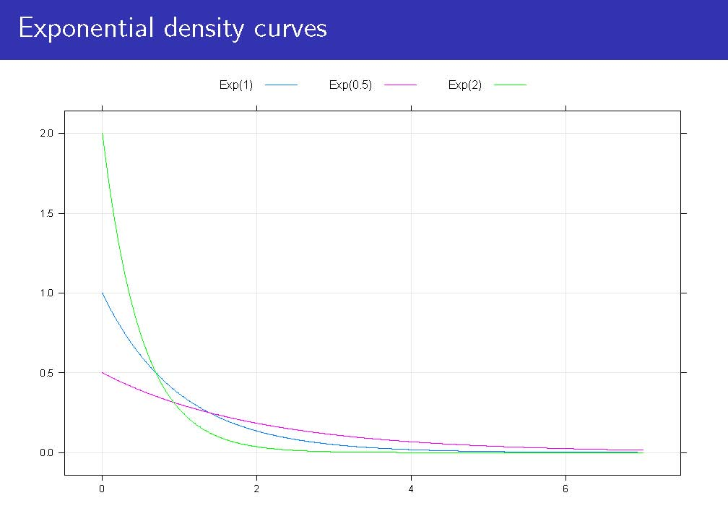
Exponential density curves

Slide 3
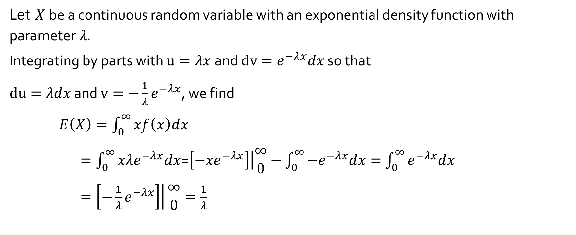
Expected value of an exponential random variable
Let $X$be a continuous random variable with an exponential density function with parameter$λ.$
Integrating by parts with $u=λx$and $dv=e^{−λx}dx$ so that
$du=λdx$ and $v={−\frac{1}{λ}e}^{−λx}$, we find
$E\left(X\right)=\int_{0}^{∞}{xf\left(x\right)dx}$
$=\int_{0}^{∞}{{xλe}^{−λx}dx}$=$\left.\left[−{xe}^{−λx}\right]\right|\begin{matrix}∞ \\ 0\end{matrix}−\int_{0}^{∞}{−e^{−λx}dx}=\int_{0}^{∞}{e^{−λx}dx}$
$\left.=\left[−\frac{1}{λ}e^{−λx}\right]\right|\begin{matrix}∞ \\ 0\end{matrix}=\frac{1}{λ}$

Slide 4
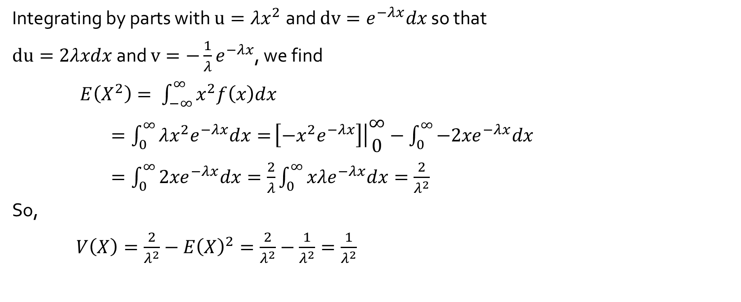
Variance of an exponential random variable
Integrating by parts with $u=λx^{2}$and $dv=e^{−λx}dx$ so that
$du=2λxdx$ and $v={−\frac{1}{λ}e}^{−λx}$, we find
$E\left(X^{2}\right)= \int_{−∞}^{∞}{x^{2}f\left(x\right)dx}$
$=\int_{0}^{∞}{λ{x^{2}e}^{−λx}dx=}\left.\left[−{x^{2}e}^{−λx}\right]\right|\begin{matrix}∞ \\ 0\end{matrix}−\int_{0}^{∞}{−{2xe}^{−λx}dx}$
$=\int_{0}^{∞}{{2xe}^{−λx}dx}=\frac{2}{λ}\int_{0}^{∞}{{xλe}^{−λx}dx}=\frac{2}{λ^{2}}$
So,
$V\left(X\right)=\frac{2}{λ^{2}}−{E\left(X\right)}^{2}=\frac{2}{λ^{2}}−\frac{1}{λ^{2}}=\frac{1}{λ^{2}}$

Slide 5
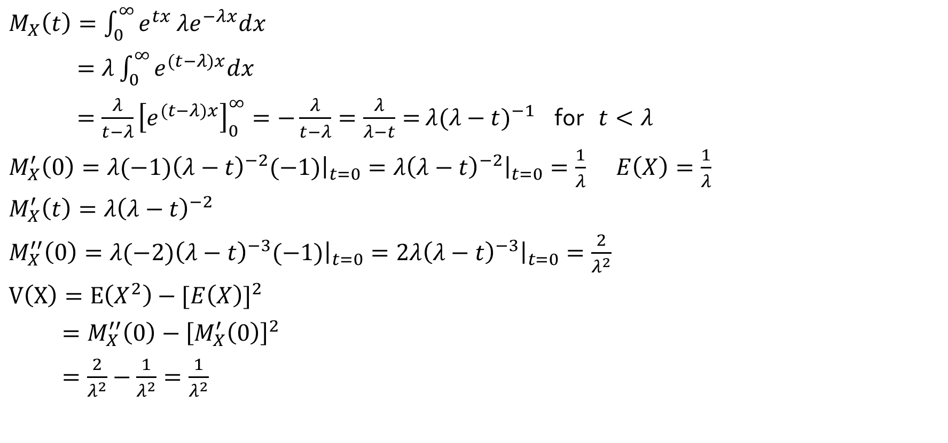
The Moment Generating Function of the Exponential Distribution**
$M_{X}\left(t\right)=\int_{0}^{∞}{e^{tx}}λe^{−λx}dx$
$=λ\int_{0}^{∞}{e^{(t−λ)x}dx }$
$=\frac{λ}{t−λ}{\left[e^{(t−λ)x}\right]}_{0}^{∞}=−\frac{λ}{t−λ}=\frac{λ}{λ−t}=$ $λ{(λ−t)}^{−1}$ for $t<λ$
$M_{X}^{′}\left(0\right)={\left.λ(−1){\left(λ−t\right)}^{−2}(−1)\right|}_{t=0}={\left.λ{\left(λ−t\right)}^{−2}\right|}_{t=0}=\frac{1}{λ}$ $E\left(X\right)=\frac{1}{λ}$
$M_{X}^{′}\left(t\right)=λ{\left(λ−t\right)}^{−2}$
$M_{X}^{′′}\left(0\right)={\left.λ(−2){\left(λ−t\right)}^{−3}(−1)\right|}_{t=0}={\left.2λ{\left(λ−t\right)}^{−3}\right|}_{t=0}=\frac{2}{λ^{2}}$
$V\left(X\right)=E\left(X^{2}\right)−{[E\left(X\right)]}^{2}$
$=M_{X}^{′′}\left(0\right)−{\left[M_{X}^{′}\left(0\right)\right]}^{2}$
$=\frac{2}{λ^{2}}−\frac{1}{λ^{2}}=\frac{1}{λ^{2}}$

Slide 6
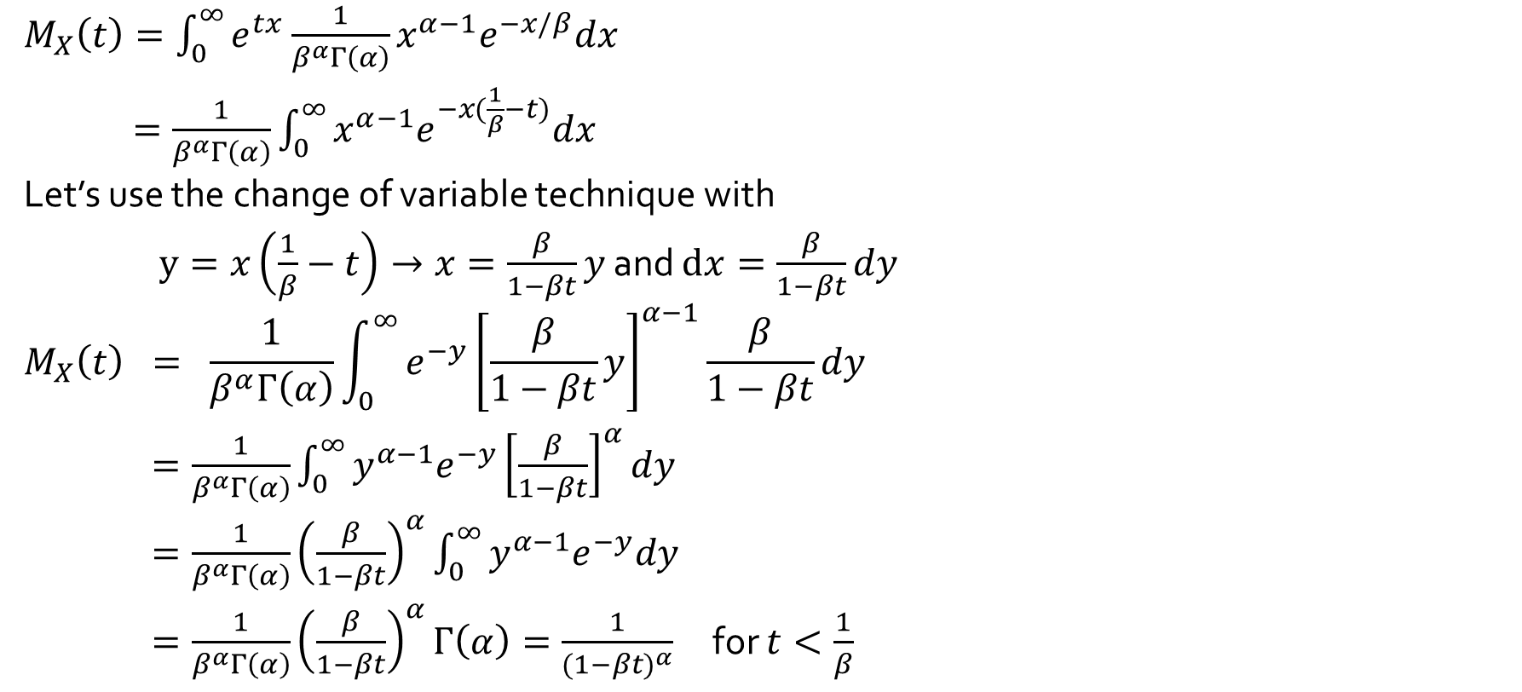
The Moment Generating Function of the Gamma Distribution**
$M_{X}\left(t\right)=\int_{0}^{∞}{e^{tx}}\frac{1}{β^{α}Γ\left(α\right)}x^{α−1}e^{−x/β}dx$
$=\frac{1}{β^{α}Γ\left(α\right)}\int_{0}^{∞}{{x^{α−1}e}^{−x(\frac{1}{β}−t)}dx }$
Let’s use the change of variable technique with
$y=x\left(\frac{1}{β}−t\right)→x=\frac{β}{1−βt}y$ and $dx=\frac{β}{1−βt}dy$
$$M_{X}\left(t\right) = \frac{1}{β^{α}Γ\left(α\right)}\int_{0}^{∞}{e^{−y}{\left[\frac{β}{1−βt}y\right]}^{α−1}\frac{β}{1−βt}dy}$$
$=\frac{1}{β^{α}Γ\left(α\right)}\int_{0}^{∞}{{y^{α−1}e}^{−y}{\left[\frac{β}{1−βt}\right]}^{α}dy}$
$=\frac{1}{β^{α}Γ\left(α\right)}{\left(\frac{β}{1−βt}\right)}^{α}\int_{0}^{∞}{{y^{α−1}e}^{−y}dy}$
$=\frac{1}{β^{α}Γ\left(α\right)}{\left(\frac{β}{1−βt}\right)}^{α}Γ\left(α\right)=\frac{1}{({1−βt)}^{α}}$ for $t<\frac{1}{β}$

Slide 7
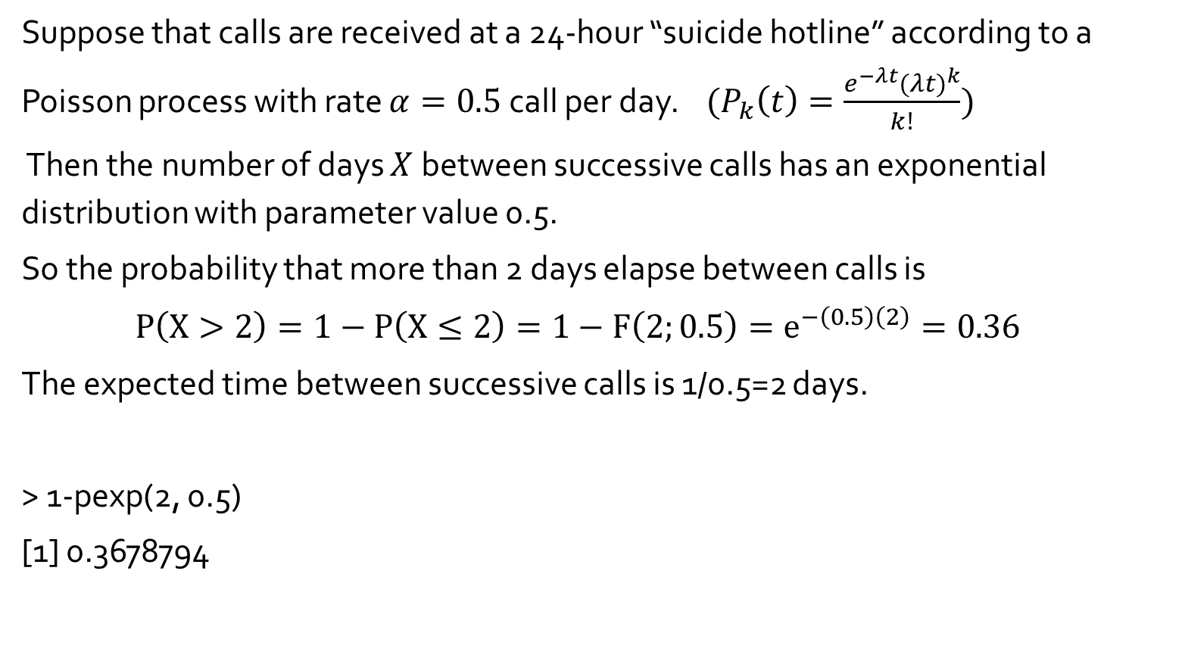
Example 4.22
Suppose that calls are received at a 24-hour “suicide hotline” according to a Poisson process with rate $α=0.5$call per day. ${(P}_{k}\left(t\right)=\frac{e^{−λt}{(λt)}^{k}}{k!})$
Then the number of days $X$between successive calls has an exponential distribution with parameter value 0.5.
So the probability that more than 2 days elapse between calls is
$P\left(X>2\right)=1−P\left(X≤2\right)=1−F\left(2;0.5\right)=e^{−\left(0.5\right)\left(2\right)}=0.36$
The expected time between successive calls is 1/0.5=2 days.
> 1-pexp(2, 0.5)
[1] 0.3678794

